Slide 1
Digital System
Chapter II. Boolean Algebra & Logic Gates
고려대학교
전기전자전파공학부
최 린

Slide 2



Binary Logic and Gates
Digital circuits
  Hardware components that manipulate binary information
  Implemented using transistors and interconnections in IC
  Each basic circuit is called logic gate
    Performs a specific logical operation
Boolean algebra
  Mathematical notation to specify the operation of each gate
    논리 회로의 특성과 분석은 영국 수학자 George Boole의 Boolean algebra에 기초함.
  George Boole (1815-1864)
    Boole approached logic in a new way reducing it to a simple algebra, incorporating logic into mathematics.
    Appointed as the first Professor of Mathematics at Queen's College, Cork
  Used to analyze and design circuits

Slide 3
Binary Logic
Binary logic
  Take binary variables that take two discrete values (0, 1) and apply three basic mathematical logic operations AND, OR, NOT
  1) AND Z = X ∧ Y = X • Y
  2) OR Z = X ∨ Y = X + Y
  3) NOT Z = ¬ X = X = X'
  -- Complement operation (0 => 1 & 1 => 0)
  Express logical relationship between binary variables
  AND/OR ≠ multiplication/addition
    Binary logic is not equal to binary arithmetic

Slide 4
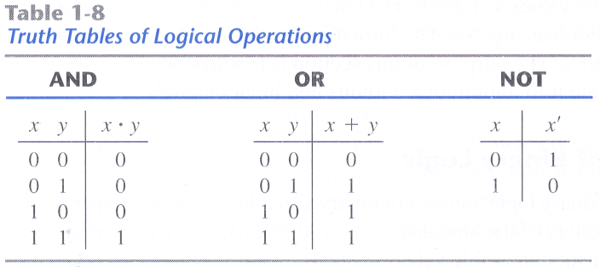


Three Binary Logic Operations

Slide 5
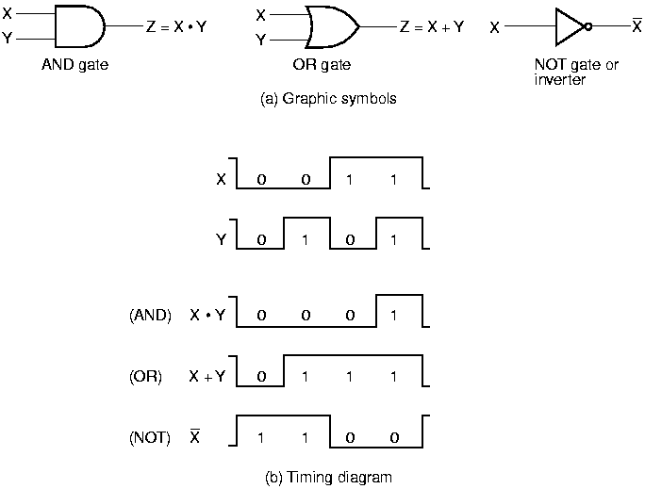
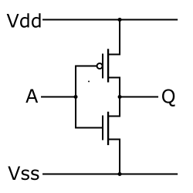
Logic Gates
Logic gates
  Electronic circuits that operate on one or more input signals to produce an output signal
  Intermediate region is crossed during state transition
CMOS inverter

Slide 6
Three Forms of Representation
Combinational logic circuit
  A combination of binary logic gates without feedback loop
Can be represented in 3 forms
  Boolean function (algebraic expression)
  Logic circuit diagram
  Truth table
  1과 2는 여러 형태가 가능한 반면 3은 1 가지 표현만 존재

Slide 7
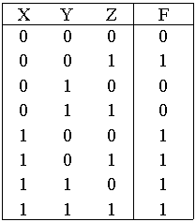
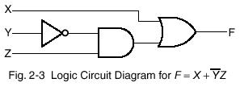
3 Forms of Combinational Circuit
Consider Boolean function F = X + Y' Z
  F = X + Y' Z

Slide 8


Boolean Algebra
Introduced by George Boole in 1854
Formal definition: postulates formulated by E. V. Huntington in 1904
  Boolean algebra is an algebraic structure defined by a set of elements B together with a set of binary operators + and · provided that the following postulates are satisfied
  A number of postulates (unproved axioms)
    (1) The structure is closed with respect to the operator +.
    The structure is closed with respect to the operator ·.
    (2) The element 0 is an identity element with respect to +: x + 0 = 0 + x = x.
    The element 1 is an identity element with respect to ·: x · 1 = 1 · x = x.
    (3) The structure is commutative with respect to +: x + y = y + x.
    The structure is commutative with respect to ·: x · y = y · x.
    (4) The operator · is distributive over +: x · (y + z) = (x · y) + (x · z).
    The operator + is distributive over · : x + (y · z) = (x + y) · (x + z).
    (5) For every element x ∈ B, there exists an element x’ ∈ B (called the complement of x) such that (a) x + x’ = 1 and (b) x · x’ = 0
    (6) There exists at least two elements x, y ∈ B such that x ≠ y.
In 1938, Shannon introduced a two-valued Boolean algebra (switching algebra) with B={0, 1}
  Shows that electrical switching circuits can be represented by this algebra.

Slide 9
Boolean Algebra
Characteristics
  Associative laws are not included, but can be derived from other postulates.
  Distributive law of + over · is valid. (not for ordinary algebra)
  Does not have additive or multiplicative inverse.
    Therefore, no subtraction or division operations are defined.
  Postulate 5 defines an operator called complement, which is not available in ordinary algebra.
Two-Valued Boolean Algebra
  Defined on a set of two elements, B = {0, 1}
  Two binary operators, and one unary operator

Slide 10
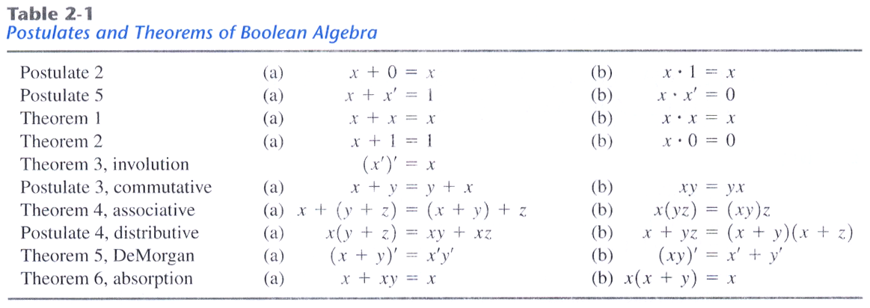
Basic Identities & Theorems
4 Postulates and 6 Theorems
  Theorems can be proven from the postulates.
Duality principle
  The postulates of Boolean algebra remains valid if we take the dual of each side
  Dual - obtained by interchanging OR and AND, and replacing 1's by 0's and 0's by 1's
Rules 1 – 9: relationship of a single variable with its complement
Rules 10 – 18: relationship of x, y, and z

Slide 11

Basic Identities
Commutative laws
  The order doesn't affect the result
  x + y = y + x, x y = y x
Associative laws
  Parentheses can be removed altogether
  x + (y + z) = (x + y) + z = x + y + z, x (y z) = (x y) z = x y z
Distributive laws (dual)
  x + y z = (x + y) (x + z)
  (A + B) (A + CD) = ?
DeMorgan’s law
  Used to obtain the complement of an expression
  Can be extended to three or more variables
  In general,
    X1 X2 … Xn = X1 + X2 + … + Xn
    X1 + X2 + … Xn = X1 X2 … Xn

Slide 12


Duality of Boolean Algebra
Dual
  Interchange OR and AND
  Replace 1's by 0's and 0's by 1's
    Rules 2, 4, 6, 8 are duals of 1, 3, 5, 7
    Rules 11, 13, 15, 17, 19 are duals of 10, 12, 14, 16, 18
Duality of Boolean Algebra
  A Boolean equation remains valid if we take the dual of the expressions on both sides of the equation
    This does not mean that the dual of the equation is equal to the original equation
    Any Boolean expression can be substituted for the variables x, y, and z

Slide 13
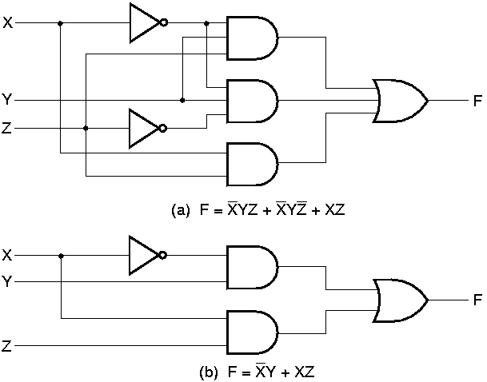

Boolean Algebra
Boolean algebra is a useful tool for simplifying digital circuits
  By applying identity rules of Boolean algebra, we can simplify a Boolean expression, i.e. simplify a digital circuit
Example
  F = X'YZ + X'YZ' + XZ
  = X'Y (Z+Z') + XZ
  = X'Y 1 + XZ
  = X'Y + XZ
  Compare two implementations
    Original F
      3 terms and 8 literals
      4 AND/OR, 2 NOTs
    New F
      2 terms and 4 literals
      3 AND/OR, 1 NOT
  Use truth table to verify two expressions

Slide 14
Boolean Algebra
Complement of a function
  Derived algebraically by applying DeMorgan's theorem
  Or, by taking dual and complementing each literal
  (Ex 2.1) Find the complement of F1 = X'YZ' + X'Y'Z
  F1' = (X'YZ' + X'Y'Z)'
  = (X'YZ')' (X'Y'Z)'
  = (X + Y' + Z) (X + Y + Z')
  (Ex 2.2) Find the complement of F1 = X'YZ' + X'Y'Z
  By taking dual and complementing each literal
  Dual of F1 (X' + Y + Z') (X' + Y' + Z)
  Comp of each literal (X + Y' + Z) (X + Y + Z')

Slide 15
Standard Forms
A Boolean function can be written in a variety of ways when expressed algebraically
Canonical forms
  A Boolean function can be expressed algebraically from its truth table
  By forming the minterm for each combination of the variables that produces 1 in the function,
  And, then taking the OR of all those terms.
  Boolean functions expressed as a sum of minterms (or product of maxterms) are said to be in a canonical form.
Minterm
  A product term in which all the variables appear exactly once
    Complemented if the bit is 0
    Uncomplemented if the bit is 1
  Represent exactly one combination in a truth table and has the value 1 for that combination & 0 for all others
  2^{n} distinct minterms for n variables

Slide 16
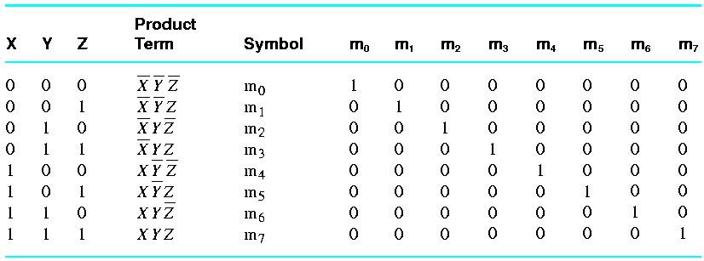
Standard Forms
  Table. Minterms for 3 Variables

Slide 17
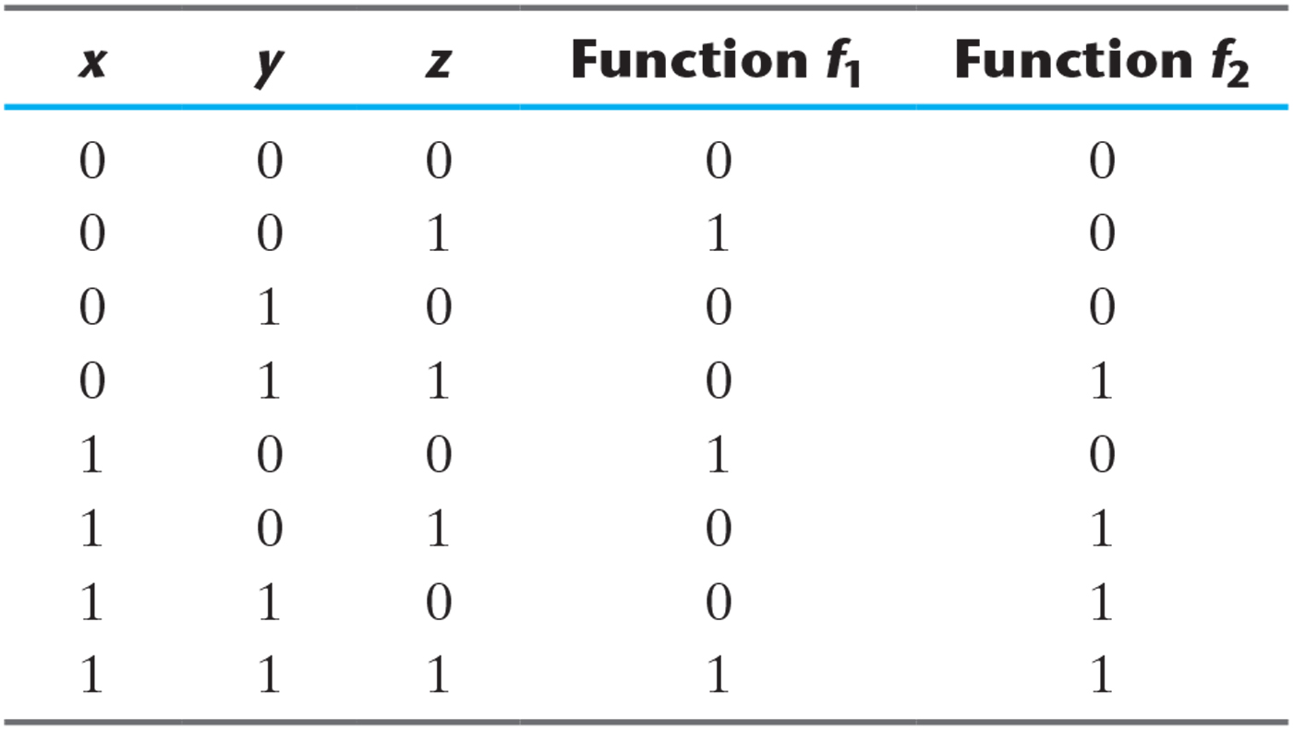
Example
Table 2-4
F1 = x’y’z + xy’z’ + xyz = m1 + m4 + m7 = ∑(1, 4, 7)
F2 = x’yz + xy’z + xyz’ + xyz = m3 + m5 + m6 + m7 = ∑(3, 5, 6, 7)

Slide 18
Standard Forms
Sum of minterms
  Contains the maximum number of literals in each term
  Usually has more product terms than necessary
Sum of products
  It is often possible to reduce the number of terms and the number of literals
  The simplified expression is called sum of products
  A Boolean function in the sum of product form can be implemented by AND gates followed by OR gates (two-level implementation)
Conversion to standard forms
  A function can be converted to the sum of minterms form by means of a truth table
  It is possible simplify the function (by either applying Boolean algebra or by using Karnaugh map) and can convert the function to the sum of products
  Two types of standard forms
    Sum of products
    Product of sums

Slide 19
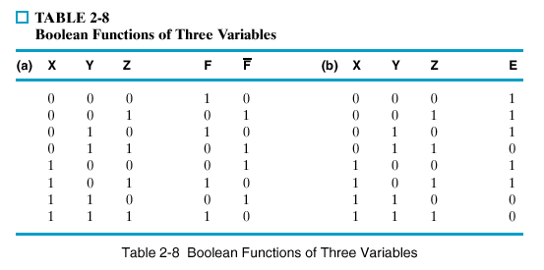
Example
Example
F = Σ m(0, 2, 5, 7)
= m₀ + m₂ + m₅ + m₇
= x’y’z’ + x’yz’ + xy’z + xyz (sum of minterms)
= x’z’ + xz (sum of products)

Slide 20
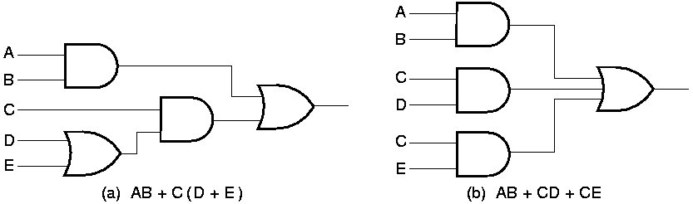
Example
If an expression is not in sum-of-products form, it can be converted to the standard form by means of the distributive laws
  (Ex) F = AB + C(D+E) (three-level)
  => AB + CD + DE (two-level)
  two-level implementation is preferred for its delay time

Slide 21
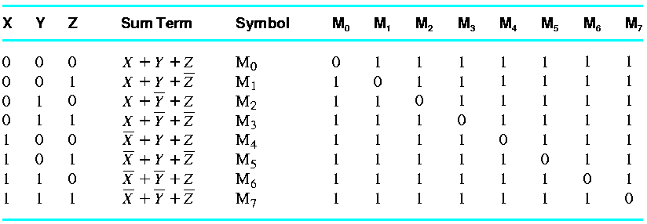
Maxterm
Maxterm
  A sum term in which all the variables appear exactly once
    Complemented if the bit is 1
    Uncomplemented if the bit is 0
  Represent exactly 1 combination in a truth table and has the value 0 for that combination and 1 for other

Slide 22
Example
Minterm vs. Maxterm
  A minterm and maxterm with the same subscript are complements of each other (M_{j} = m_{j}')
  (Ex) (m₃)' = ( X' Y Z )' = X + Y' + Z' = M₃
Conversion between Canonical Forms
  For the previous example
  F = Σ m(0, 2, 5, 7), F’ = Σ m(1, 3, 4, 6)
F = Σ m(1, 3, 4, 6)
= m₁ + m₃ + m₄ + m₆
= m₁ • m₃ • m₄ • m₆
= Π M(1, 3, 4, 6)
= M₁ • M₃ • M₄ • M₆
= (x + y +z’)(x + y’ + z’)(x’ + y + z)(x’ + y’ + z)

Slide 23
Standard Forms
Canonical forms
  A function can be converted to the product of maxterms from its truth table
  By forming the maxterm for each combination of the variables that produces 0 in the function,
  And, then taking the AND of all those terms.
  Boolean functions expressed as a product of maxterms are said to be in a canonical form.
Product of sums
  It is possible simplify the function (by either applying Boolean algebra or by using Karnaugh map) and can convert the function to the product of sums
  Product of sums is also a standard form
  Example F= M₁ • M₃ • M₄ • M₆
  = (x + y +z’)(x + y’ + z’)(x’ + y + z)(x’ + y’ + z)
  = (x + z’ + yy’)(x’ + z + yy’)
  = (x + z’)(x’ + z)

Slide 24
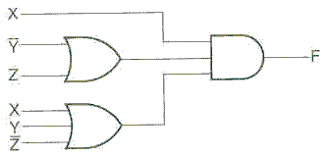
Standard Forms
  (Ex) F = X(Y'+Z)(X+Y+Z')
  Needs 2 OR gates and one AND gates

Slide 25
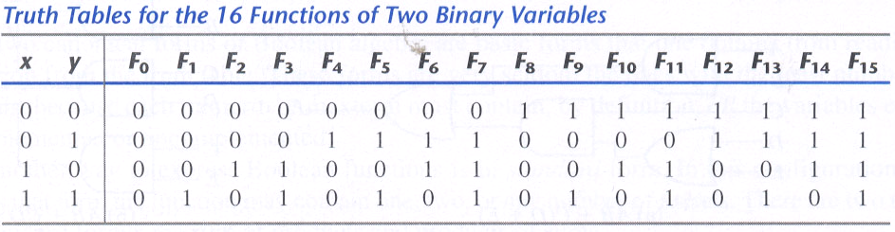
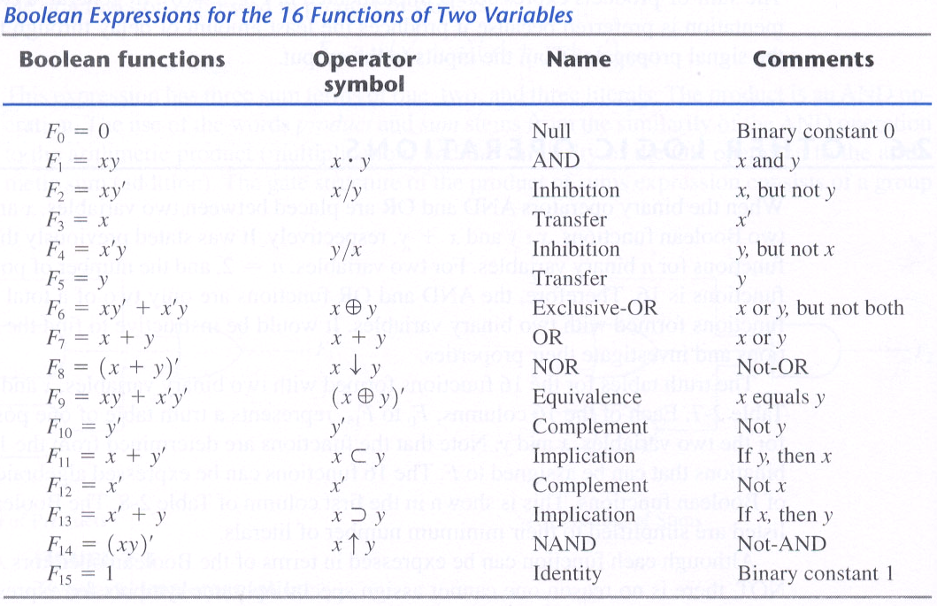
Binary Logic Operations

Slide 26
Binary Logic Operations
2 input operations
  2 constant functions: produce 0 or 1
  4 functions with unary operations: transfer and complement
  10 binary operators
    AND, OR, NAND(↑), NOR(↓), XOR, XNOR (Equivalence)
    2 inhibitions and 2 implications
For 2 input variables
  2² = 4 minterms
  2⁴ = 16 functions

Slide 27
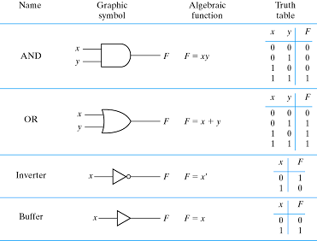
Digital Logic Gates

Slide 28
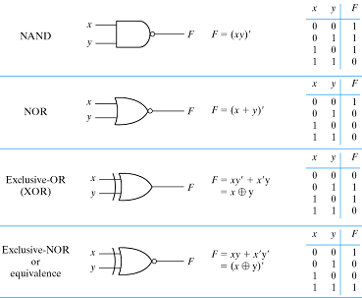
Digital Logic Gates

Slide 29
Extension to Multiple Inputs
A gate can be extended to have multiple inputs if the binary operation it represents is commutative and associative
AND/OR are both commutative and associative.
  Thus, the AND/OR gate can be naturally extended to have multiple inputs
NAND/NOR are commutative, but not associative
  (x↓y)↓z≠x↓(y↓z)
    (x↓y)↓z = [(x+y)'+z]' = (x+y)z'= xz' + yz‘
    x↓(y↓z)= [x+(y+z)'] ' = x'(y+z)= x'y + x'z
Redefine multiple input NAND/NOR as a complemented AND/OR gate
  x↓y↓z= (x+y+z)'
  x↑y↑z= (xyz)'
XOR/XNOR are both commutative and associative
  Thus, the XOR/XNOR gate can be naturally extended to have multiple inputs

Slide 30
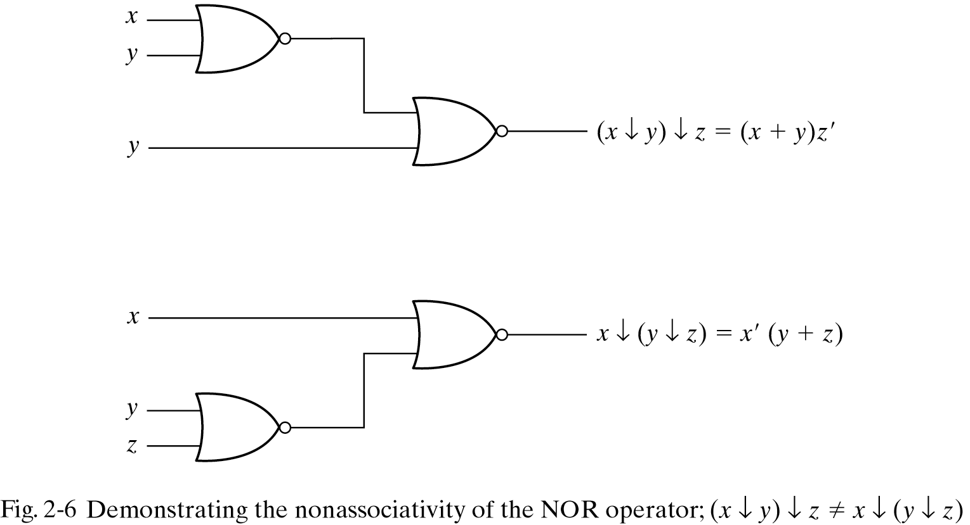
Non-associativity of the NOR gate

Slide 31
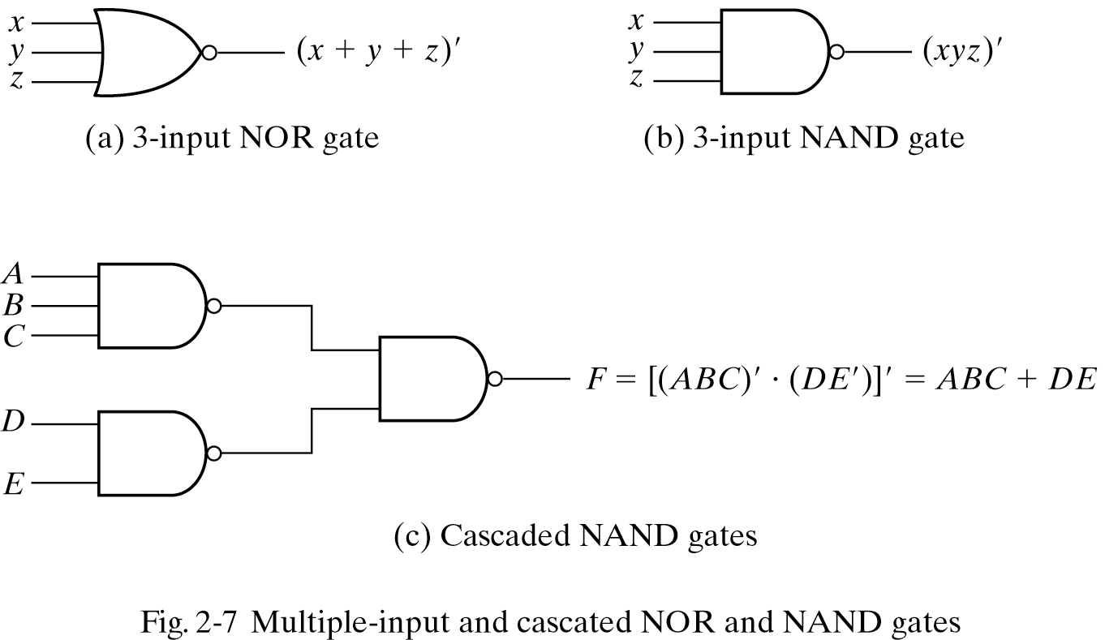
Cascaded NAND gates

Slide 32
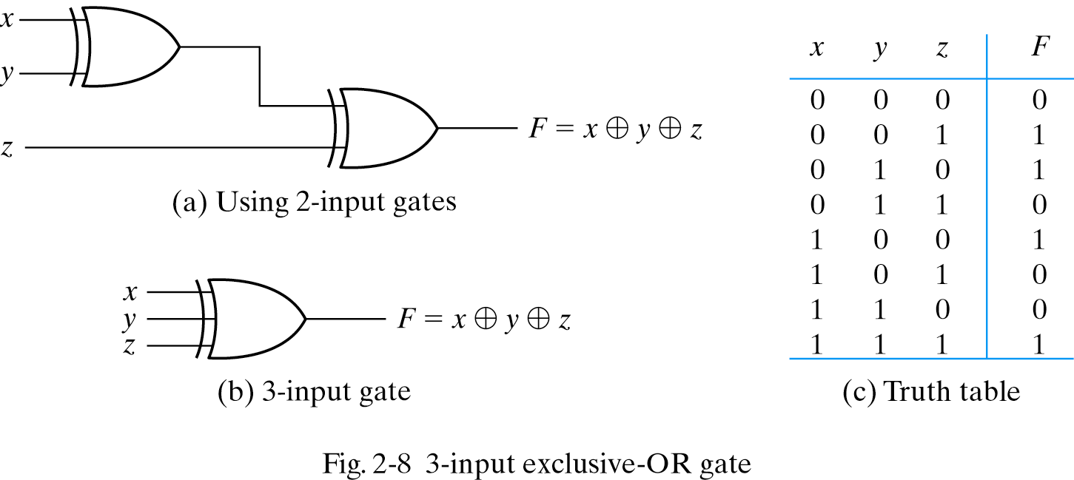
3-input XOR Gate

Slide 33
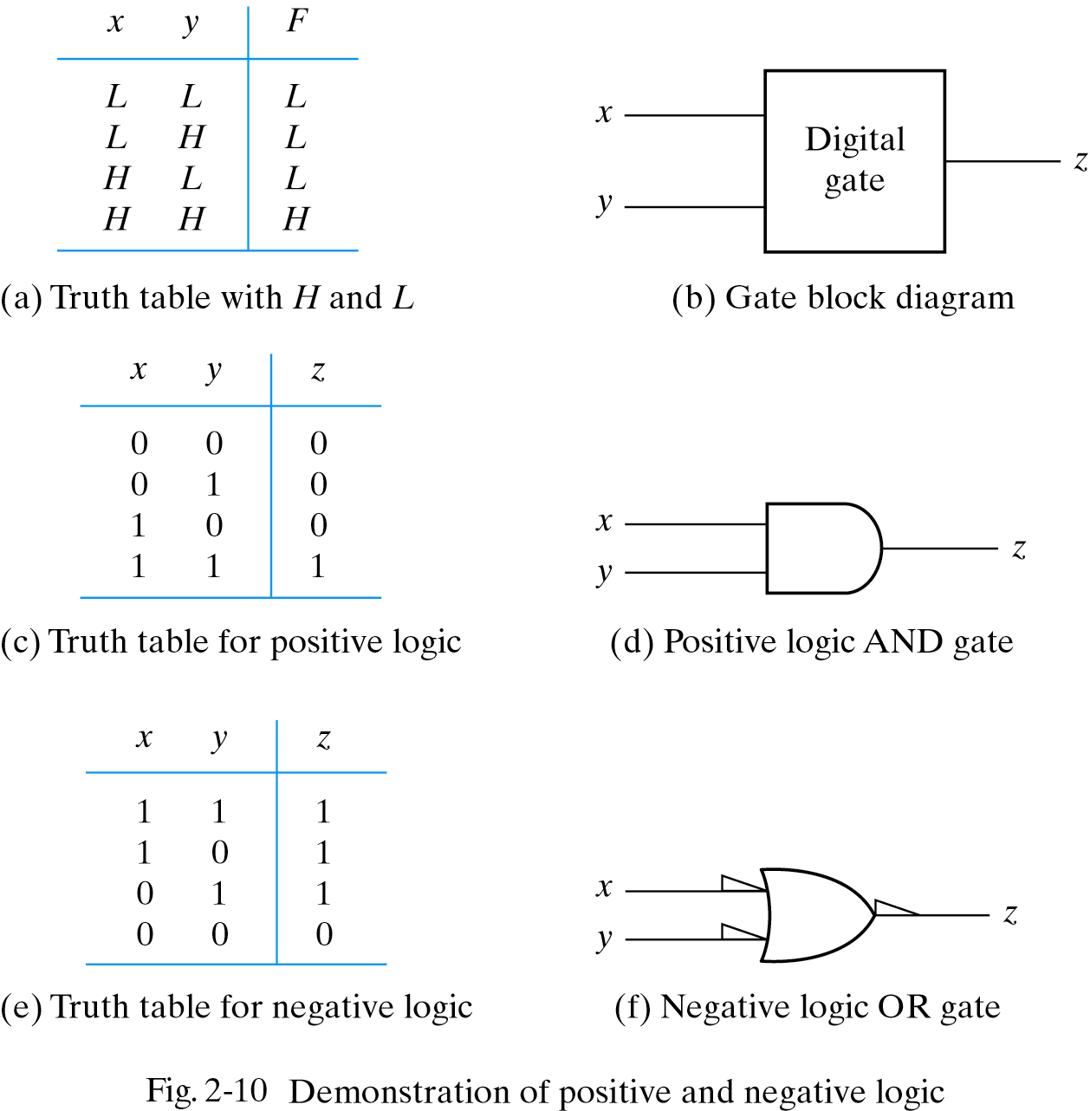
Positive and Negative Logic
  The same physical gate can operate either as a positive-logic AND gate or as a negative-logic OR gate.

Slide 34
Integrated Circuits
An integrated circuit (IC) is a silicon semiconductor crystall, called a chip.
  Various gates are interconnected inside the chip to form digital circuits.
  The chip is mounted in a ceramic (or plastic) container called a package.
    Signals and power lines are connected to external pins in the package.
Levels of integration
  SSI (Small-Scale Integration) – < 10 gates
  MSI (Medium-Scale Integration) – 10 ~ 1000 gates
  LSI (Large-Scale Integration) – thousands of gates
  VLSI (Very Large-Scale Integration) – hundred of thousands of gates
    Most of the IC’s nowadays are VLSI’s

Slide 35
Integrated Circuits
Digital Logic Families - logic gates can be implemented by transistors with different technologies
  TTL (Transistor-Transistor Logic) – widespread in the past
  ECL (Emitter-Coupled Logic) – high speed operation
  MOS (Metal-Oxide Semiconductor) – high component density
  CMOS (Complementary Metal-Oxide Semiconductor)
    Dominant technology due to its low power consumption and high density
  BiCMOS - CMOS + TTL, used selectively
  GaAs – very high speed
Parameters of the gate
  Fan-in – # inputs
  Fan-out – # loads that the output can drive
  Noise margin – the maximum noise voltage on an input that will not cause an undesirable change in the output
  Power dissipation – power consumed by the gate
  Propagation delay – delay time of a signal to propagate from input to output

Slide 36
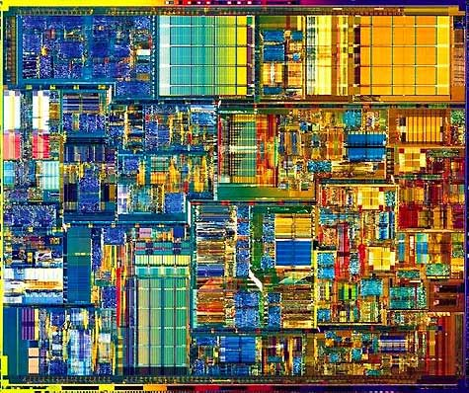

What’s inside a CPU?
Pentium 4 Processor Die on 0.18 micron (42M transistors)
400MHz
system bus
Advanced
Transfer Cache
Pipeline
Trace cache
FP/MMX

Slide 37
Logic Level : Gates

Slide 38
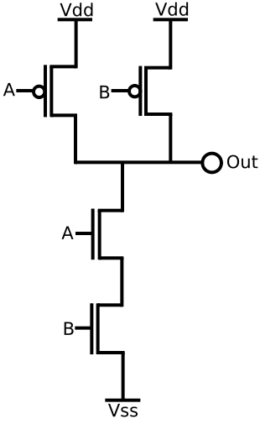
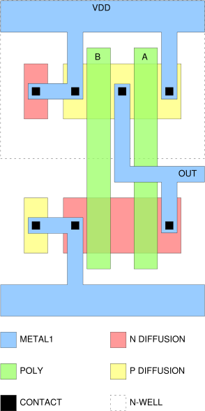
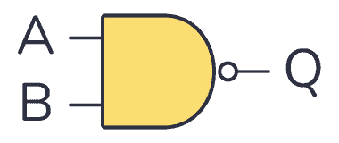
Circuit Level: Transistors
2-input CMOS NAND Gate Physical Layout

Slide 39
Homework II
Read Chapter 3
PROBLEMS
  2.1
  2.3
  2.4
  2.7
  2.10
  2.13
  2.17
  2.18
  2.28

